Slide 1
Midterm Presentation

Slide 2

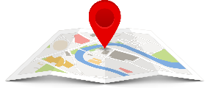


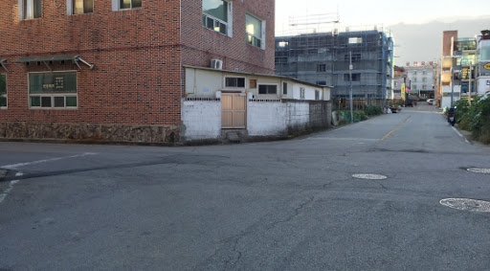
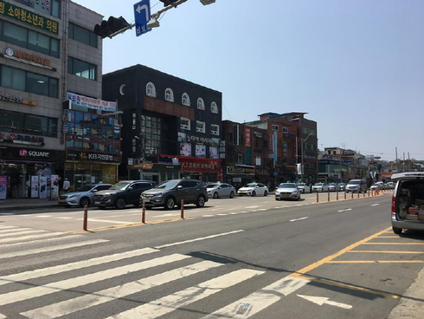
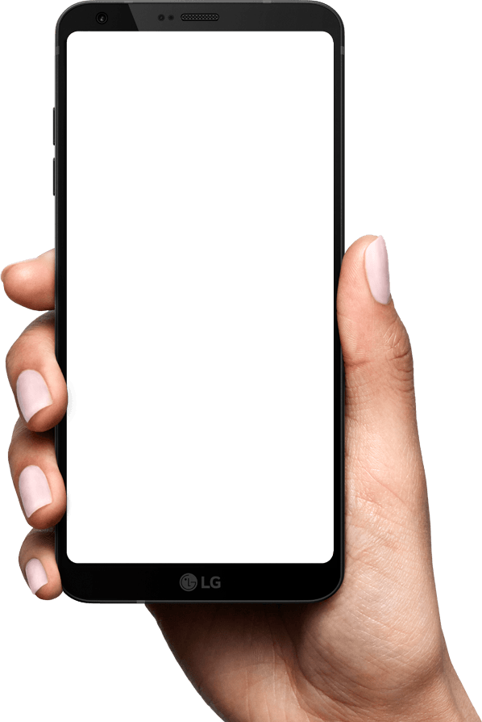
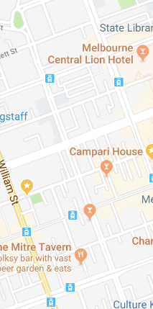
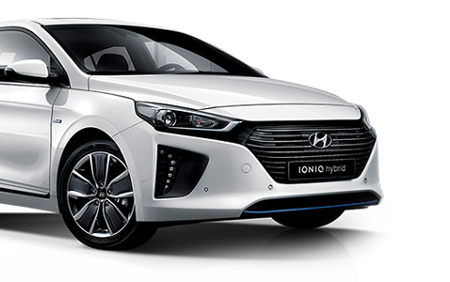


Key Idea
Enhancing Traffic Situation Awareness by Sensors(Bluetooth, GPS, etc.,)
We alert pedestrians of dangerous situation by using
Warning!
Car is approaching
Warning!
Intersection ahead
Beacon

Slide 3
Proposed Idea - 성현

Slide 4
Demonstration – 도형

Slide 5


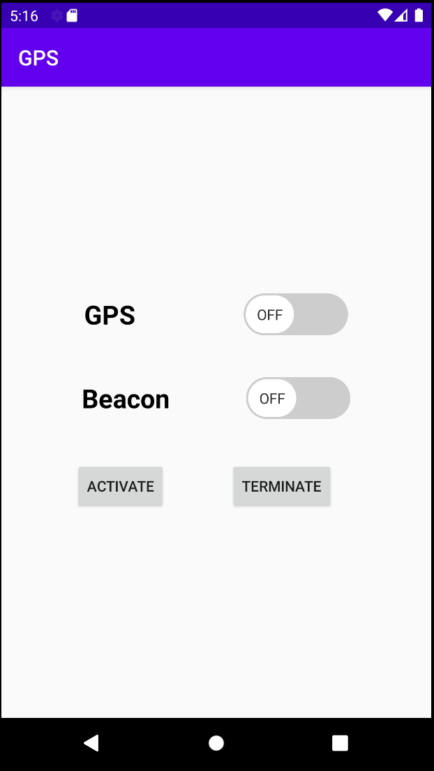




System Architecture
Server
Mobile
Apache
< GPS Service>
PHP
MySQL
“Caution”
< Beacon Table >
ID | Name | Status
1 | Beacon 1 | Deactivated
.
.
.
.
.
.
< Beacon Service>
< User Table >
“Beep”
ID | Name | Status
1 | Mike | Activated
.
.
.
.
.
.

Slide 6
System Overview – GPS Service
GPS Service
Longitude
Latitude
Location Provider
GPS2ADDR
Address
Request
AccidentInfo
API
History
Response
ParsePolygon
Polygons
OccurrenceCheck
Alert Message
Alarm Service

Slide 7

System Overview – Beacon Service
BLE Bluetooth Scan Service
Alarm
Service
Beep Sound Frequency Down
Beacon
Service
Get Beacon List Result
Beep Sound Frequency UP
Current Beacon List
Last Beacon List
Do Beep Sound
None
Get Beacon RSSI value
Far From Here
Check Distance Beacon
Close

Slide 8
Techinal Challenges
Challenge 1 :
Localization when location of beacon varies over time
Solution
- Proximate based approach ()
Challenge 2 :
Low GPS accuracy or coarse resolution
Solution
- Approximate user location based on nature of walking

Slide 9
Evaluation strategy
Measure the device alerts at the proper time and distance
check if the alert is sent or not in a proper time
measure the latency from when data is received to when alert is sent
Experiment is conducted in several use cases with varying parameters
speed of the vehicle
speed of the pedestrian (mobile device)
distance between the vehicle and the pedestrian (mobile device)
Count the number of occasions of correct alert and analyze the result
distance and speed range to provide guaranteed notification

Slide 10
Evaluation – GPS

Slide 11
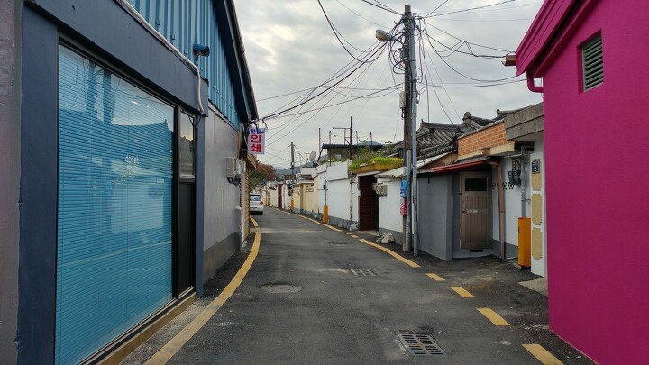

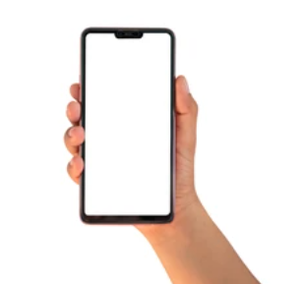

Final deliverable
Android based mobile application that recognizes nearby moving vehicles and alerts the user when they are close enough.
Success Criteria
The effective of the application will be shown based on the experiment.
알림: 움직이는 차가
10m 거리에 있습니다.

Slide 12
Project Management - 진

Slide 13
Overall project plan
K : Kim, Do Hyung
P : Park, Seonghyeon
C : Choi, Jin
Milestone | Item | 3 |  | 4 |  |  |  | 5 |  |  |  |  | 6
 |  | 4 | 5 | 1 | 2 | 3 | 4 | 1 | 2 | 3 | 4 | 5 | 1
Proposal | Prepare presentation | K, P, C
Review/Demo (May 3) | Design the overall architecture |  | K, P, C
 | Build application |  |  | K, P | K, P | K, P
 | Build server |  |  | C | C | C
 | Prepare demonstration |  |  |  |  |  | K, P, C
Final presentation (June 7) | Test and improve the functionalities of the application |  |  |  |  |  |  | K, P | K, P
 | Test and improve the functionalities of the server |  |  |  |  |  |  | C | C
 | Experiment and analyze the result |  |  |  |  |  |  |  |  | K, P, C | K, P, C | K, P, C
 | Prepare demonstration |  |  |  |  |  |  |  |  |  |  | K, P, C | K, P, C
 | Prepare final presentation |  |  |  |  |  |  |  |  |  |  |  | K, P, C

